Slide 1
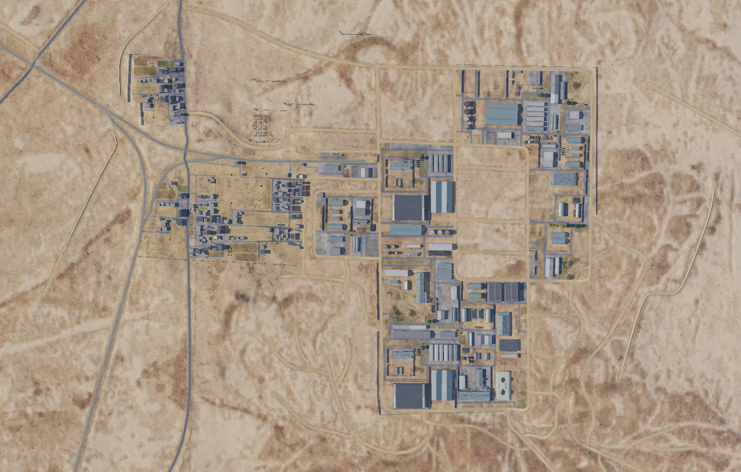

OPARTGT059 Chemical Weapon - Sarqiyha Research Centre
N
59
2
DESCRIPTION OF THE DESIRED POINTS OF IMPACT WITH WPN TYPE:
OPARTGT059A – Research Centre
DPI 1 N34 12.807 E038 01.671/1969ft/(2000 Ibs bomb)
DPI 2 N34 12.810 E038 01.640/1978ft/(2000 lbs bomb)
OPARTGT059B – Testing Facility
DPI 3 N34 12.753 E038 01.646/1975ft/(1000 Ibs bomb)
OPARTGT059C – Chemical Storage
DPI 4 N34 12.645 E038 01.630/1952ft/(1000 Ibs bomb)
OPARTGT059D – Production
DPI 5 N34 12.660 E038 01.497/1946ft/(2000 Ibs bomb)
1
3
5
4
4
5
6
Collateral Damage Concerns in immediate area.
7
8

Slide 2
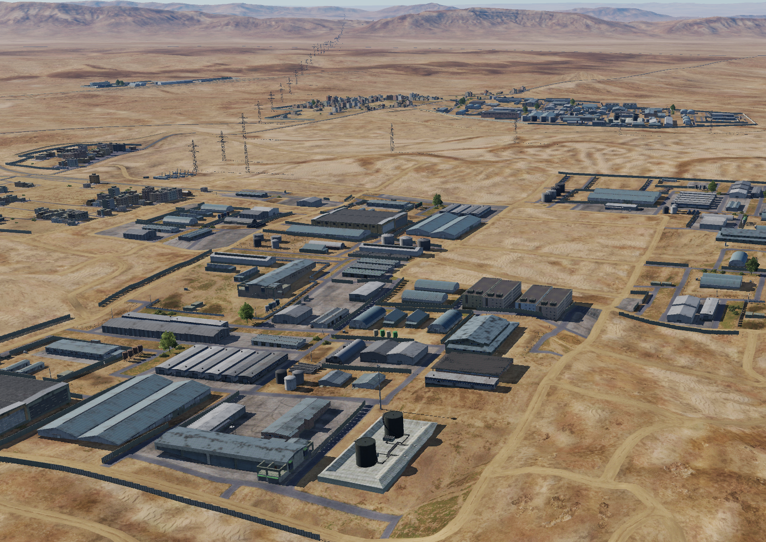
OPARTGT059 Chemical Weapon - Sarqiyha Research Centre DPI’s
N
N
OPARTGT059A
2
1
OPARTGT059D
1
3
5
OPARTGT059B
4
OPARTGT059C
OPARTGT059A – 5 storey buildings made of concrete slab supported by reinforced concrete base and pillars, flat poured roof.
OPARTGT059B - 3 storey buildings made of concrete slab supported by reinforced concrete base and pillars, flat poured roof, requires delayed fuzing.
OPARTGT059C – Chemical storage tanks. Triple skinned metal structure surrounded by poured concrete bung.
OPARTGT059D – Single storey prefabricated concrete walls with poured concrete roof supported by reinforced concrete pillars..

